Slide 1


Path to Health/Camino A La Salud
Provider Billing
&
Claims Training
Presented By
Linda Boyd, AMM Director of Administration

Slide 2


Important Notice
        Path to Health Participating Organizations:
        Ampla Health
        Clinicas de Salud del Pueblo, Inc.
        Coastal Alliance
        Communicare Health Center
        Community Medical Center
        El Dorardo Community Health Center
        La Clinica de la Raza
        Madera Community Hospital Family Health Services
        Marin Community Clinic
        Mendocino Community Health Clinics Inc.
        Ole Health
        Open Door Community Health Centers
        Oroville Hospital Rural Health Clinics
        Petaluma Health Center
        Ritter Center
        San Benito Health Foundation
        Santa Rosa Community Health
        Shasta Community Health Center
        Tehama County Health Services Agency
        Winters Healthcare Foundation
This training is specific to the Path to Health participating clinic organizations only.
All Path to Health participating sites underwent a detailed application process, prior to contract eligibility with the program.
If your organization is a not listed as part of the 20 Path to Health participating sites, the following training information does not apply.

Slide 3
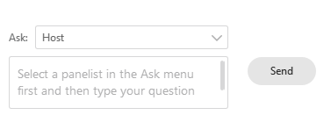
Meeting Logistics
Questions & Answers
To ask a question, you will type your question into the “Chat” box in the lower right corner of the screen and click “Send” to the Host. All questions or technical assistance issues, should be asked via the Chat box.
Questions will be answered at the end of the presentation as time allows.

Slide 4

Q & A Test
Using the Chat Box, please type in your name, the name of the Clinic you are representing and your email address.
Please make sure to select the host, “Chris Salmon, HOST” , from the drop-down selection each time you send your Chat message. Let’s do a test run.
For Example:
Type & Submit “Alison, ABC Clinic, Alison1@gmail.com

Slide 5
A recording of this training will be available on August 15th at http://pathtohealth.amm.cc/Providers
To access the recording, please enter the password indicated on the website.
Presentation Follow Up

Slide 6
Key Terms & Abbreviations
Abbreviation/Term | Definition
CMSP | County Medical Services Program
Alluma | Path to Health Enrollment System Vendor
AMM | Advanced Medical Management - administrator for medical claims
MedImpact | Pharmacy Benefit Manager
FPL | Federal Poverty Level
BIC | Beneficiary Identification Card – issued by Medi-Cal
PPS | Prospective Payment System
Camino a la Salud | Path to Health in Spanish

Slide 7
AGENDA
Background & Program Overview
Eligibility & Enrollment
Member ID Card & Guide
Emergency Medi-Cal vs. Path to Health
Claims Submission
Turn Around Times & Expectations
Appeals
Provider Support
Q & A

Slide 8
TARGET POPULATION
PURPOSE
The mission of the Path to Health Pilot Project is to:
Promote timely delivery and preventative medical services to improve health outcomes
Reduce the use of emergency services and inpatient hospitalization
Enable Community Health Centers to redirect resources to other needs
Up to 25,000 undocumented adults, ages 26+, resident of one of CMSP’s 35 counties
Enrolled in restricted scope/emergency only Medi-Cal
DURATION
The Path to Health Pilot Project:
Began enrolling members in February 2019
Ends on January 31, 2022 – unless extended again by the CMSP Governing Board

Slide 9
Path to Health Pilot Program Overview
Pilot Program Start
February 2019
Added Clinics
November 2019
Additional Clinics Go-Live
August 2020
Petaluma Clinic, Santa Rosa Clinic, Ampla Health,
Coastal Alliance,
Communicare Health Centers,
Community Medical Centers,
La Clinica de La Raza,
Marin Community Clinics,
Ole Health,
San Benito Health Foundation, &
Shasta Community Health Center
Go-Live
Ritter Center,
Madera Community Hospital Family Health Services,
Winters Healthcare Foundation, &
Tehama County Health Services Agency Clinics Go-Live
Clinicas de Salud del Pueblo, Inc.,
Mendocino Community Health Clinic Inc.,
Open Door Community Health Centers
& Oroville Hospital Rural Health Clinics
Pilot Program End
January 31, 2022

Slide 10
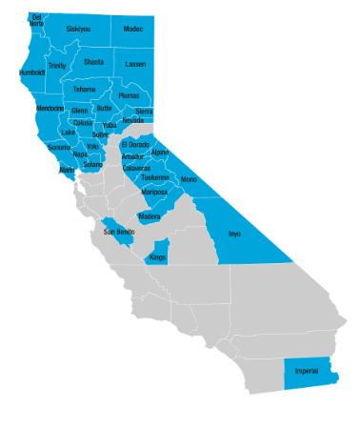
Path to Health
Participating Counties
        20 Path to Health Clinic Organizations located in 20 of CMSP’s 35 Counties:
        Butte
        Colusa
        Del Norte
        El Dorado
        Glenn
        Humboldt
        Imperial
        Lake
        Madera
        Marin
        Mendocino
        Napa
        Shasta
        Solano
        Sonoma
        Sutter
        Tehama
        Yolo
        Yuba
        San Benito

Slide 11
Path to Health
Eligibility

Slide 12
Eligibility
To enroll in Path to Health Program, a person must:
      Be a resident of one of CMSP’s 35 counties.
  Be 26+ years old at the time of enrollment.
  Be enrolled in 1 of 30 restricted scope/ emergency only Medi-Cal Aid Codes:
1U, 3T, 55, 58, 5F, 5T, C1, C2, C3, C4, C5, C6, C7, C8, D2, D3, D4, D5, D6, D7, J3, J4, J6, J8, K3, K5, K7, K9, M2, or M4
  (Medi-Cal enrollment will continue through county social services)
  Apply and be enrolled for Path to Health at a participating clinic location.
Enrolled members will receive the Path to Health benefit for up to six months, even if their Medi-Cal aid code changes.

Slide 13
Eligibility For Undocumented Adults
Income | Emergency Services Coverage | Primary & Preventative Coverage
0 – 138% FPL | Medi-Cal | Effective 2/2019: Path to Health with certain limitations
139% – 300% FPL | CMSP | CMSP under Primary Care Benefit with certain limitations

Slide 14
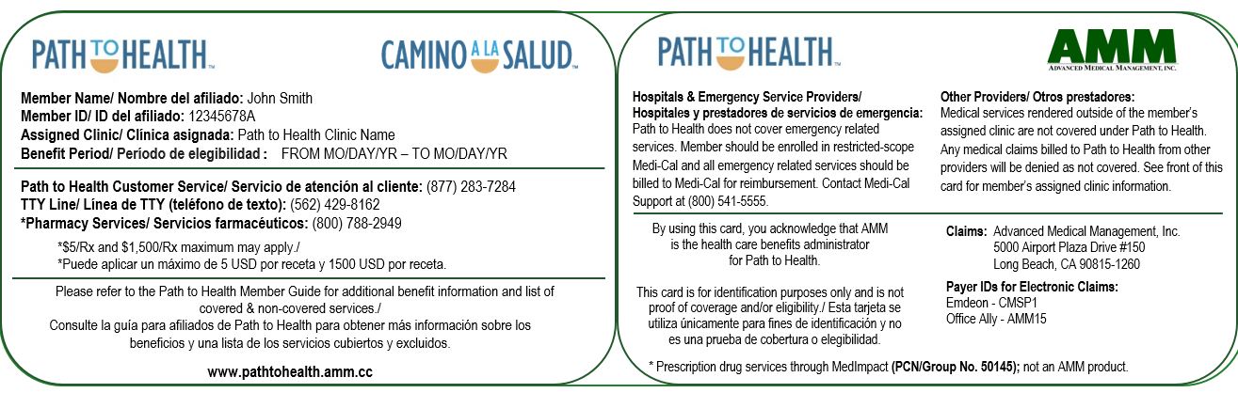
Path to Health Member ID Card
Following enrollment in the Path to Health Program, the member will receive a Path to Health ID Card (issued & mailed by AMM).

Slide 15

Medi-Cal Beneficiary ID Card (BIC)
The member should have also received a State of California Beneficiary Identification Card (BIC) to use for restricted-scope Medi-Cal benefits.
New Version
Old Version
*Please note, both versions of the BIC are valid.

Slide 16
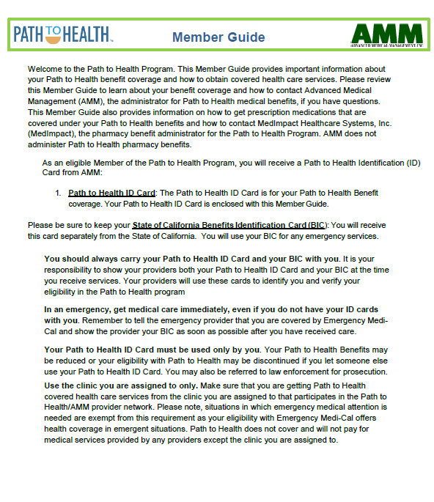
Path to Health Member Guide
Members will receive a Path to Health Member Guide along with their ID Card that contains information regarding covered services and important contacts.
For a full copy of the member guide, visit: https://pathtohealth.amm.cc/members
Notes:
Expectations for receiving ID Card and member guide.

Slide 17
Eligibility Verification
To complete the Path to Health enrollment process, Community Health Centers will be responsible for registering the patient’s information through the secure registration/enrollment portal maintained by the CMSP Governing Board as well as consent from the patient to participate in the Pilot Program.
For eligibility support or questions, please contact the Path to Health Helpdesk at (800) 548-5880.
Providers can verify eligibility via the enrollment system website or by contacting AMM Customer Service at (877) 283-PATH (7284).
Members are eligible for a period of up to 6 months. Eligibility start and end dates are located on the member’s Path to Health ID Card and can be verified using the Path to Health Enrollment System.
Once enrolled, members are eligible to receive Path to Health approved services on the same day.
REMEMBER:
Health Centers must complete and submit the User Access Request form to gain access to the Enrollment Portal.
Contact csalmon@cmspcounties.org for more information.

Slide 18
Clinic Assignments
Member assignments to clinics are at the clinic system level. So the member may access services at their assigned clinic’s locations if more than one.
For example: Ampla Health has 12 sites participating in the pilot. The Path to Health member could be served by all 12 Ampla sites.
Changing Clinic Assignment: If a member is enrolled with another clinic organization but would like to be seen within your clinic system, you must disenroll the member from their original clinic organization and re-enroll the member with the Path to Health Program under your parent organization. The new clinic assignment won’t take effect until the following day.
For example: A Path to Health enrolled member comes into a Community Medical Center clinic for services but has been assigned to La Clinica de La Raza as their clinic provider. Staff at the Community Medical Center Clinic can go onto the Path to Health enrollment portal, find the member’s eligibility application, disenroll the member from La Clinica de La Raza and complete a new application to re-enroll the member under Community Medical Center.

Slide 19
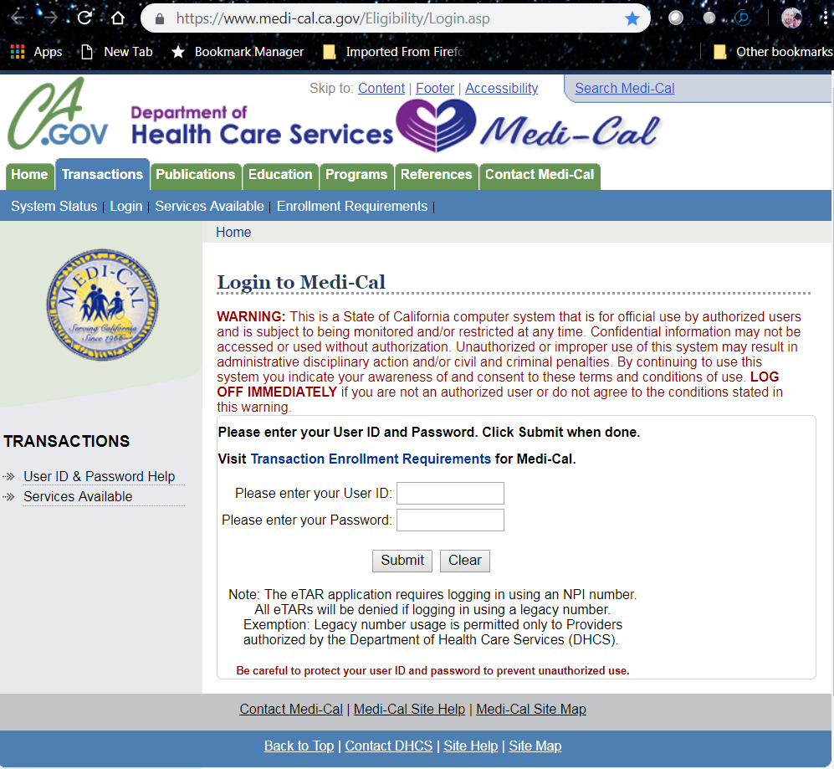
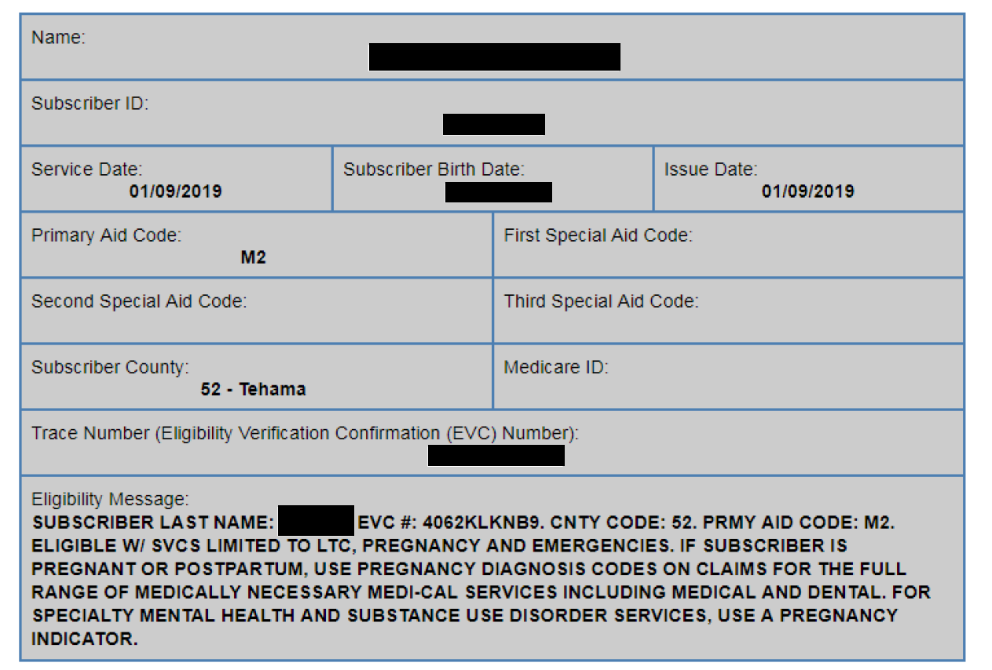
Checking Medi-Cal Online
  Be enrolled in 1 of 30 restricted scope/ emergency only Medi-Cal Aid Codes: 1U, 3T, 55, 58, 5F, 5T, C1, C2, C3, C4, C5, C6, C7, C8, D2, D3, D4, D5, D6, D7, J3, J4, J6, J8, K3, K5, K7, K9, M2, or M4
NOTE: Medi-Cal Eligibility Message will not reference Path to Health after enrollment

Slide 20
Path to Health Covered Benefits

Slide 21

Path to Health Covered Benefits
  Office Visits
  Minor Medical Procedures
  Preventative Screenings
  Routine Lab Test
  Adult Immunizations
  Prescription Medication
For the full list of covered benefits, please see the Path to Health Provider Operations Manual or visit https://pathtohealth.amm.cc/Providers

Slide 22
Emergency Medi-Cal vs. Path to Health Benefits
Services | Path to Health (Services must be rendered at member’s assigned clinic organization or in-network pharmacy in order to be payable by Path to Health) | Emergency Medi-Cal (Excluding pregnancy circumstances. Billing & Reimbursement based on Medi-Cal Guidelines)
Non-Emergent Clinic Visits & Minor Medical Procedures
Preventative Screenings including HIV, HPV, Hepatitis B/C, & STI Screenings
Routine Lab Tests & Adult Immunizations
Prescription Medications (Specialty Medications Excluded)
Life Threatening Emergencies
Emergency Room Visits & Emergent Medications
Inpatient Hospital Admissions Related to Emergency Conditions

Slide 23
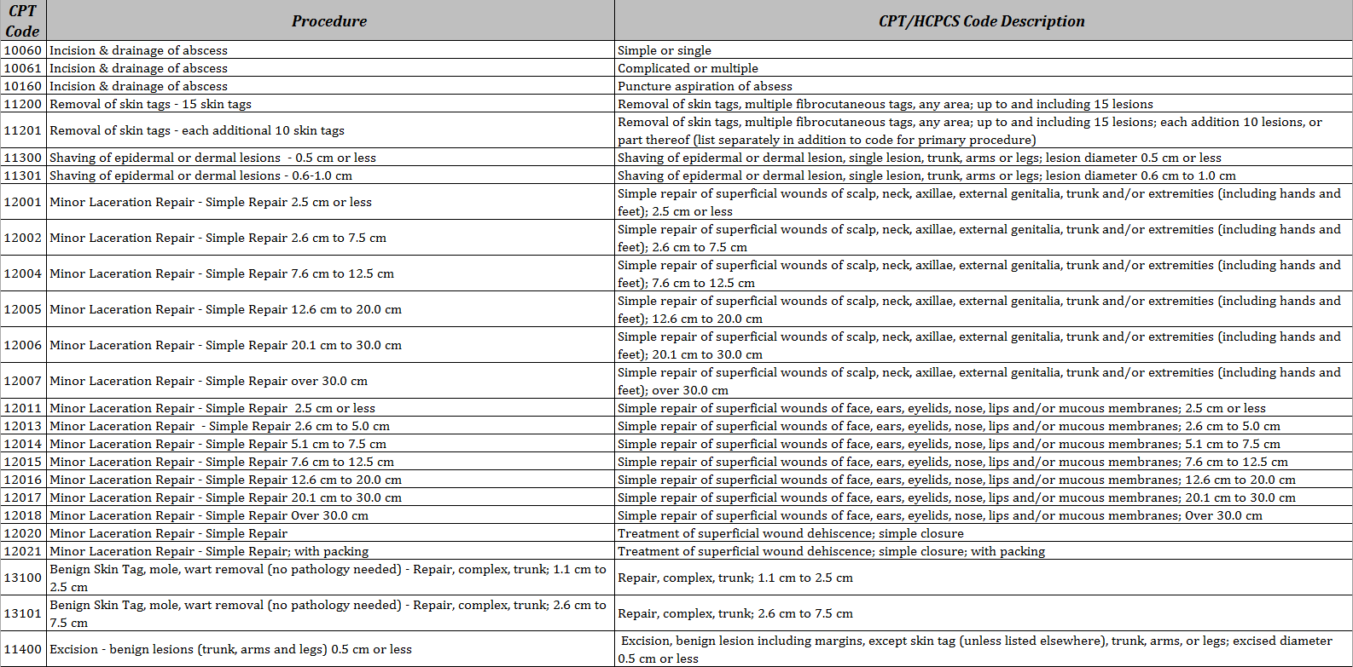
Path to Health Approved Procedure Codes
Click Here for the full list of Path to Health Approved Procedure Codes: https://pathtohealth.amm.cc/Documents/Path%20to%20Health%20Approved%20Procedure%20Code%20List.pdf

Slide 24
COVID-19 TESTING
As of March 4, 2020, Path to Health will provide coverage for COVID-19 diagnostic testing, not otherwise covered by MediCal, to Path to Health members at no cost. This includes no cost for any provider office visit in order to receive COVID-19 testing. Important items to note:
  Path to Health has added COVID-19 test codes U0001, U0002, and 87635 to the list of approved billable CPT codes for Path to Health.
  Diagnosis codes are to be billed in accordance with CMS ICD-10 coding guidelines.
For ICD10 Guidelines: https://www.cdc.gov/nchs/data/icd/10cmguidelines-FY2020_final.pdf

Slide 25
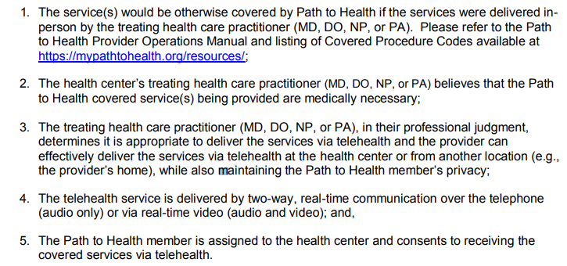
Telehealth Services During the State of Emergency
Retroactive to dates of service on or after March 4, 2020, Path to Health contracted health centers may provide telehealth services to Path to Health members during the COVID-19 State of Emergency in California if all of the conditions listed on the April 30, 2020 Provider Bulletin are met:

Slide 26
Telehealth Coding and Documentation
1. Thoroughly document the visit as if the visit had occurred in person, including but
not limited to:
              Detailed patient history and complete description of the covered benefit provided
An assessment/examination of the issues being raised by the patient
Medical decision-making by the health care practitioner of low, moderate, or high complexity, as applicable, which should include items such as pertinent diagnosis(es) at the conclusion of the visit, and any recommendations for diagnostic studies, follow-up or treatments, including prescriptions
2. Use the appropriate CPT codes for the particular service(s) rendered.
3. Use the appropriate modifier 95, GT, or GQ.
4. Health centers are not required to use Place of Service 02.
    5. AMM may request medical records for a particular patient in the instance of
    multiple Telehealth visits to the same Provider.

Slide 27
Telehealth Corrected Claims
Submitting Corrected Telehealth Claims:
              If health centers have already submitted telehealth claims to Path to Health without using any telehealth modifiers, please resubmit corrected claims that include telehealth modifiers to AMM.
Paper UB-04 Claims:
Please indicate “Corrected Claim” on the claim preferably in box 80 (remarks) and enter the value of 7 (replacement of prior claims) in the third digit of the Type of Bill [XX7] in Box 4. Add the appropriate telehealth modifier to the professional service CPT or HCPCS code (for example, 99214-95 or 99213-GQ).
Electronic 837I submissions:
Resubmit including the appropriate telehealth modifier and indicate a “Corrected Claim.”
For more details to the above, reference the Provider Bulletin dated April 30, 2020
Delivery and Billing of Telehealth Services:
https://mypathtohealth.org/wp-content/uploads/2020/04/Telehealth_PathtoHealthProviderBulletin_04302020.pdf

Slide 28
Path to Health Pharmacy Benefits
Covered medications are available at a $5 copayment per prescription and prescription coverage is limited to a maximum of $500 per claim and a $1500 maximum benefit per Path to Health enrollment period.
For questions regarding covered prescription drugs, or
If you require assistance with pharmacy billing, please contact:
MedImpact Customer Service
(800) 788-2949
To access the full prescription drug formulary and list of participating pharmacies, visit https://mypathtohealth.org/resources/

Slide 29
Non-Covered Services
Please Note the Following Services are NOT covered under the Path to Health Program, therefore they will NOT be eligible for reimbursement:
Any medical service provided at a location other than member’s assigned clinic
  Acupuncture, including podiatry-related acupuncture services
Methadone Maintenance Services
Breast and Cervical Cancer treatment services
Optometry services and eye appliances
Chiropractic care
Public transportation
Cosmetic procedures
Dental services
Services by a Psychologist, LCSW, MFT or substance use disorder counselor
Family planning services (including contraceptives and family planning counseling and education)
Pregnancy-related and infertility services (including abortions)
                ***Post-Partum Services are only covered 60 days after the pregnancy delivery date; please supply medical records when submitting claims to verify the delivery date.

Slide 30
Additional Resources
For Contraceptives & Family Planning Services, please contact:
Family PACT (916) 650-0414
For Pregnancy-Related Services, please contact:
Medi-Cal (800) 541-5555
For Breast and Cervical Cancer Screening Services, please contact:
Every Woman Counts (916) 449-5300
For Breast and Cervical Cancer Treatment Services, please contact:
Breast & Cervical Cancer Treatment Program (BCCTP) (800) 824-0088

Slide 31
Path to Health Claims Submission

Slide 32
Reimbursement Rates
Clinics will be reimbursed at their corresponding PPS rate for each qualifying visit for a Path to Health member.
Services must be rendered by the member’s assigned clinic organization and must be on the pre-approved list of codes in order to be reimbursable.
Reminder: The Path to Health Approved Procedure Code List is available online:
https://pathtohealth.amm.cc/Documents/Path%20to%20Health%20Approved%20Procedure%20Code%20List.pdf

Slide 33
Path to Health Claims Submission
Claims must be submitted on a UB-04 Claim Form.
          **Please Note: Claims submitted on CMS-1500 Claim Form will be denied as an invalid claim form.
Claims must be submitted using member’s Path to Health ID Number (Same as the 9-digit Medi-Cal CIN)
Claims can be submitted electronically (preferred) or via mail
Timely Filing of Claims
  First Time Claims Submission – 150 Calendar Days from the Date of Service
Claim Resubmissions – 60 Business Days from the Denial Date

Slide 34
Paper Claim Submissions
Submit Paper Claims to:
Path to Health - Advanced Medical Management, Inc.
Attn: Claims Department
5000 Airport Plaza Dr., Suite 150
Long Beach, CA 90815-1260

Slide 35
Electronic Claim Submissions
Submit Electronic Claims to any of the following Clearinghouses:
Office Ally – www.officeally.com
  Support Phone #: (360) 975-7000 Opt. 1
  Payer ID: AMM15
  Emdeon/Change – https://cda.changehealthcare.com/portal
    Support Phone #: (888) 363-3361
    Payer ID: CMSP1
  Claimremedi – https://claimremedi.providersportal.com
  Support Phone #: (800) 763-8484
  Payer ID: CMSP
    Gateway/Trizetto - http://www.trizetto.com
            Support Phone #: (800) 556-2231
            Payer ID: UMM15

Slide 36
Checking Claims Status
You can check the status of your submitted claims using the AMM Claims Manager.
To Register, visit https://claims.amm.cc/Register.aspx
Please allow 24 hours for your account to be approved after registering. Once approved, visit https://claims.amm.cc/Login.aspx to check on the status of your claims.

Slide 37
Claims Appeals
Appeal forms can be found at: http://pathtohealth.amm.cc/providers
Appeals must be faxed or mailed within 60 business days from the claim denial date.
    Mail
    CMSP – Advanced Medical Management, Inc.
Attn: Claims Department
5000 Airport Plaza Drive, Suite 150
Long Beach, CA 90815-1260
Fax
562-766-2007
or

Slide 38
Path to Health Important Contacts

Slide 39
Key Websites
For more information regarding the Path to Health Program, visit:
www.caminoalasalud.org
www.mypathtohealth.org
https://pathtohealth.amm.cc
Notes:
Add go live date for websites. 2/1/19

Slide 40

Provider Materials Packet
A packet containing Path to Health related materials will be e-mailed to each of the sites upon joining the program
Included in the Packet:
A copy of the Member Guide
The Provider Operations Manual
The Path to Health Pre-Approved Procedure Code List
Additional Path to Health materials
Notes:
Add go live date for websites. 2/1/19

Slide 41
Important Contact Information
AMM Customer Service
CMSP /Path to Health Third Party Administrator
(877) 283-PATH (7284)
https://pathtohealth.amm.cc/Contact
MedImpact Customer Service
Path to Health Pharmacy Services Administrator
(800) 788-2949

Slide 42

Q & A
To ask a question, you will type your question into the “Chat” box in the lower right corner of the screen and click “Send” to Chris Salmon, Host.

Slide 43

Thank you for Attending!

